Slide 1

FROM YOUR EYES
CUSTOM EDGE AI ASSISTANT
Zülal Tannur
Founder and CEO

Slide 2

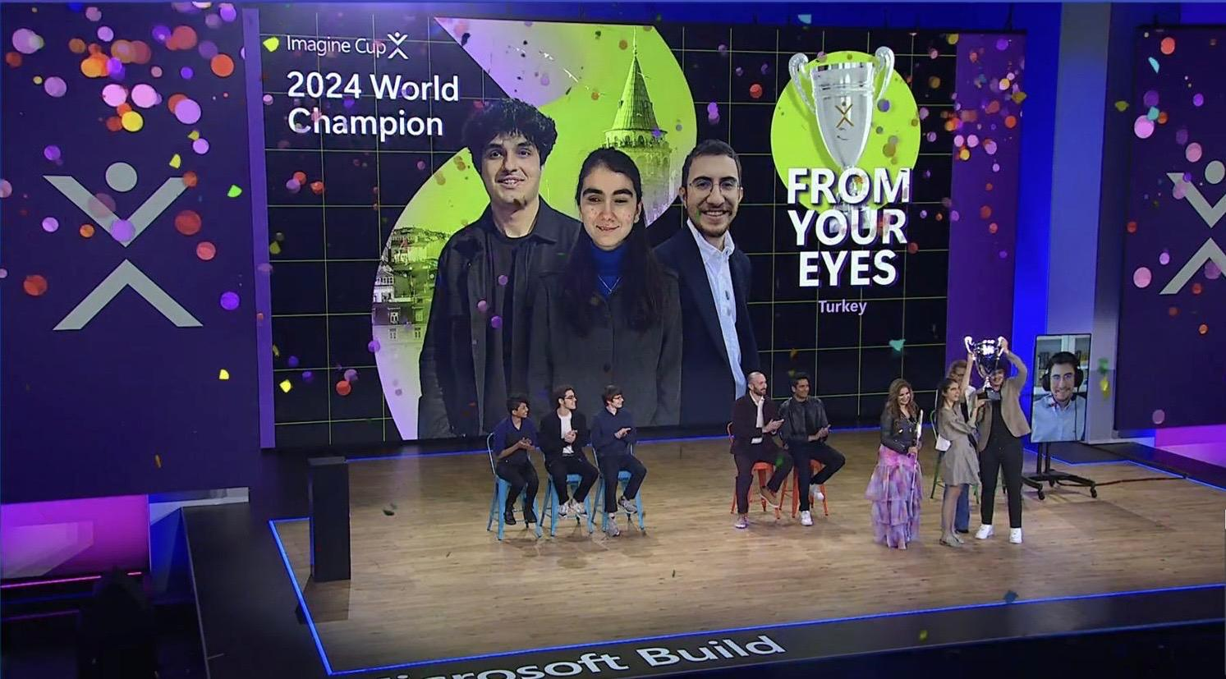
ABOUT US
We are a ‘’Layer 2 Artificial Vision Company’’ offering fully customizable edge computing solutions.
Founded April 13, 2023, Istanbul, Turkey
Generated $60,000 USD in Revenue (2M TL)
Secured $45,000 USD in Angel Investment
Microsoft Imagine Cup 2024 World Champion
Premier global technology startup competition
$100,000 prize
Mentorship session with Microsoft Chairman and CEO, Satya Nadella

Slide 3
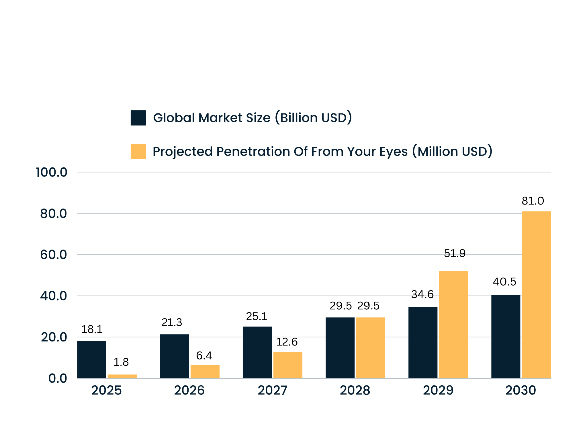
GLOBAL ARTIFICIAL VISION MARKET PENETRATION

Slide 4

VALUE PROPOSITIONS
LMM to Edge
LMMs (Layer 1) have very large and complex structures.
However, due to intensive computational costs, they do not target specific customizations and localized requirements.
Therefore, requires Layer 2 Solutions like us!
OUR APPROACH
We act on 2 Specific Pillars
Localization
Federated Learning and Edge Computing
Customization
Real-Time Video Image and AI Customization

Slide 5

LMM TO EDGE
CUSTOMIZATION
Static data sets
Broad Use Cases (Flexibility)
Intensive Computational Power
Complex Customization
SOLUTION
We developed and trained our in-house model to customize the dynamic content with speed and accuracy tracking user preferences and history.
KEY TECHNICALS
98% Accuracy | 8% higher accuracy than standard accepted percentage
Can Differentiate 865 Colors
4 ms Inference Time | 2,5 times faster than most of the commercial solutions

Slide 6

LMM TO EDGE
LOCALIZATION
Privacy-Centric Training
High Cost, Energy and Time Consumption
Cloud Dependency
SOLUTION
We act under 2 main items;
Federated Learning
Data Privacy and Security
Reduced Bandwidth
Edge Computing
Low Latency
Notes:
Fotoğrafın backgroundsuz bir icon olması daha iyi olur.

Slide 7
SOLUTIONS
SO, WHAT WE DO…
FYE API
FYE MOBILE VISION
FYE VEHICLE VISION
The FYE API enables developers to integrate advanced visual data processing into their applications, fostering innovation across various industries.
The FYE Mobile App offers visually impaired users advanced real-time image processing and accessibility solutions to enhance their daily lives.
FYE Vehicle Vision provides real-time image processing and advanced virtual travel assistance through edge computing, compatible with any vehicle.

Slide 8

REVENUE MODEL
SAAS
FYE MOBILE VISION
B2B Licensing
Medium & Large Institutions
Developers
Scalable Price Packages
Pay as You Go / Fixed Plans
Usage Based Ranges

Slide 9

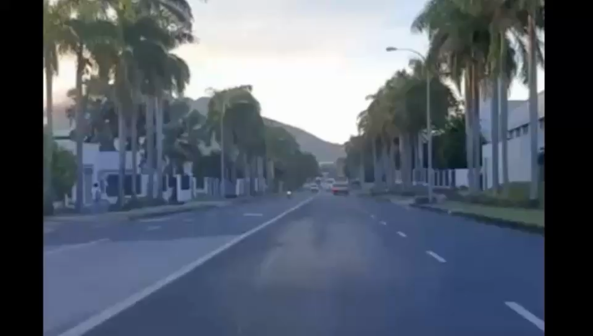
Virtual Travel Companions
In-Cabin Monitoring
Road Condition Monitoring
Personalized Entertainment
Driver Assistance
Low Latency
Data Privacy
Smart Vehicles
Demo Video is Here.

Slide 10

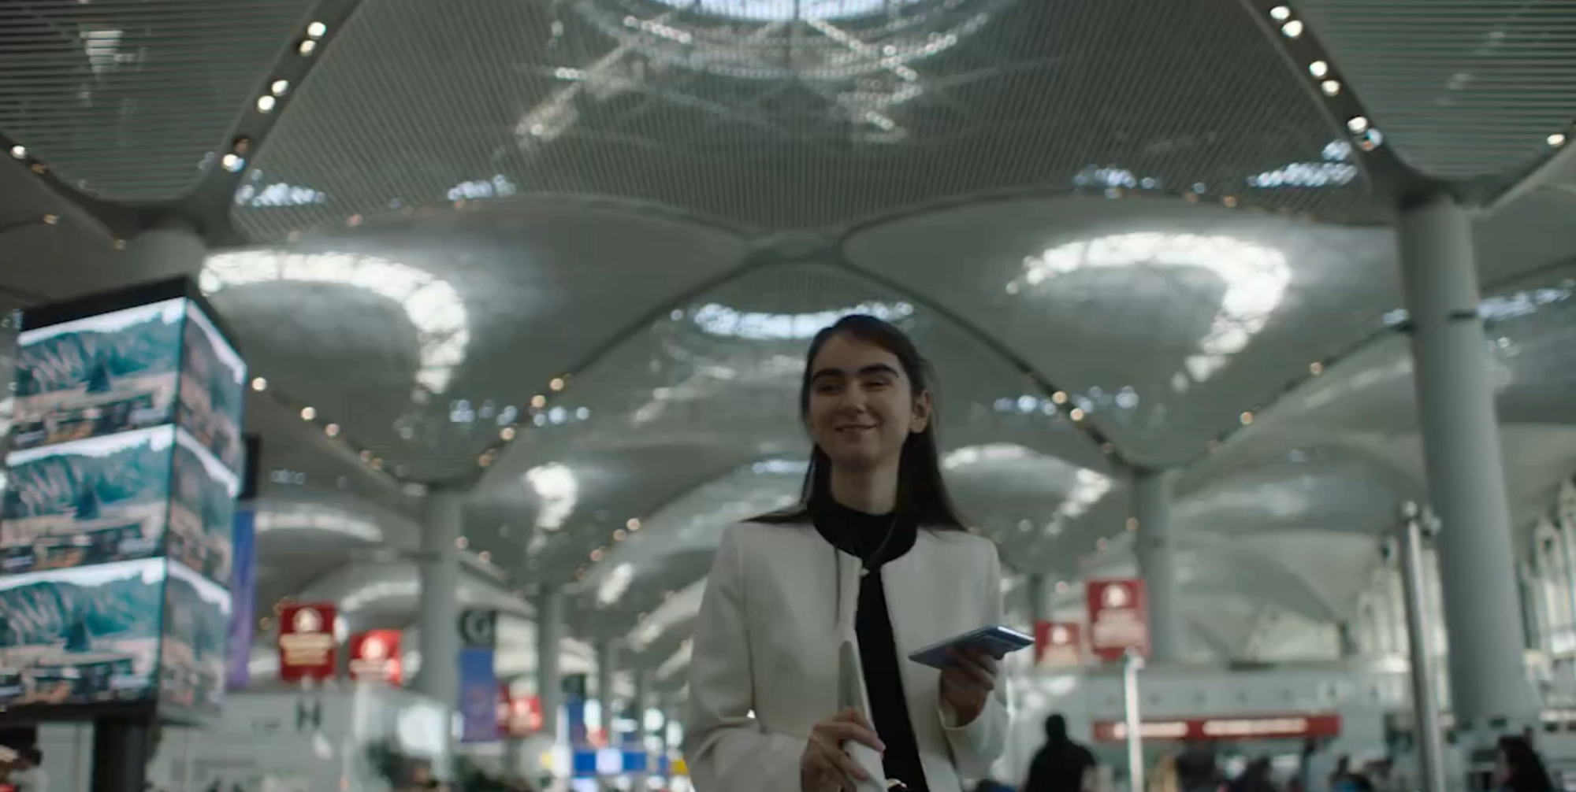
Fully Independent
Travel Experience
Enhanced Mobility
Personalized Assistance
Enhanced Accessibility
Enhanced Mobility
Smart Airport

Slide 11
USER STATS
+50 COUNTRIES
+7000 USER
NOV 2023
DEC 2023
JAN 2024
FEB 2024
MAR 2024
APR 2024
MAY 2024
JUN 2024

Slide 12

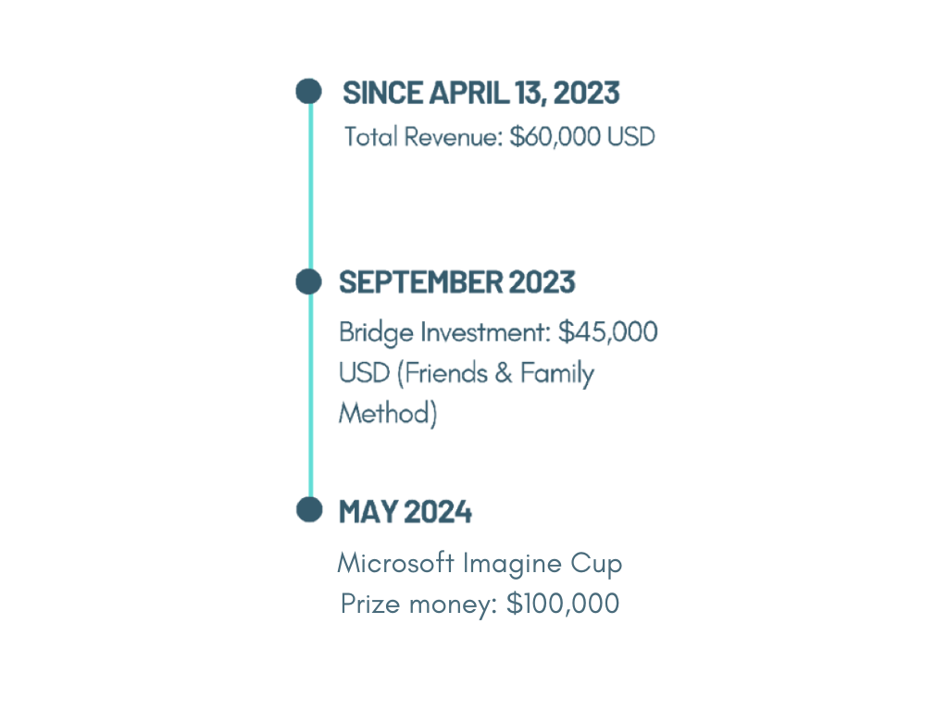


Strategic Partnerships
FROM YOUR EYES - ACHIEVEMENTS AND PARTNERSHIPS
Financial Performance and Investments
TOGG - Turkey's First Domestic Car: A key partner in the mobility sector.
Istanbul Airport - Europe's Largest Airport: A major partner for accessibility and artificial vision technologies.
EIT INNOMOTION Program: One of the startups in the EIT portfolio under the INNOMOTION program.
We won the Imagine Cup and will receive a mentorship session with Microsoft Chairman and CEO, Satya Nadella

Slide 13
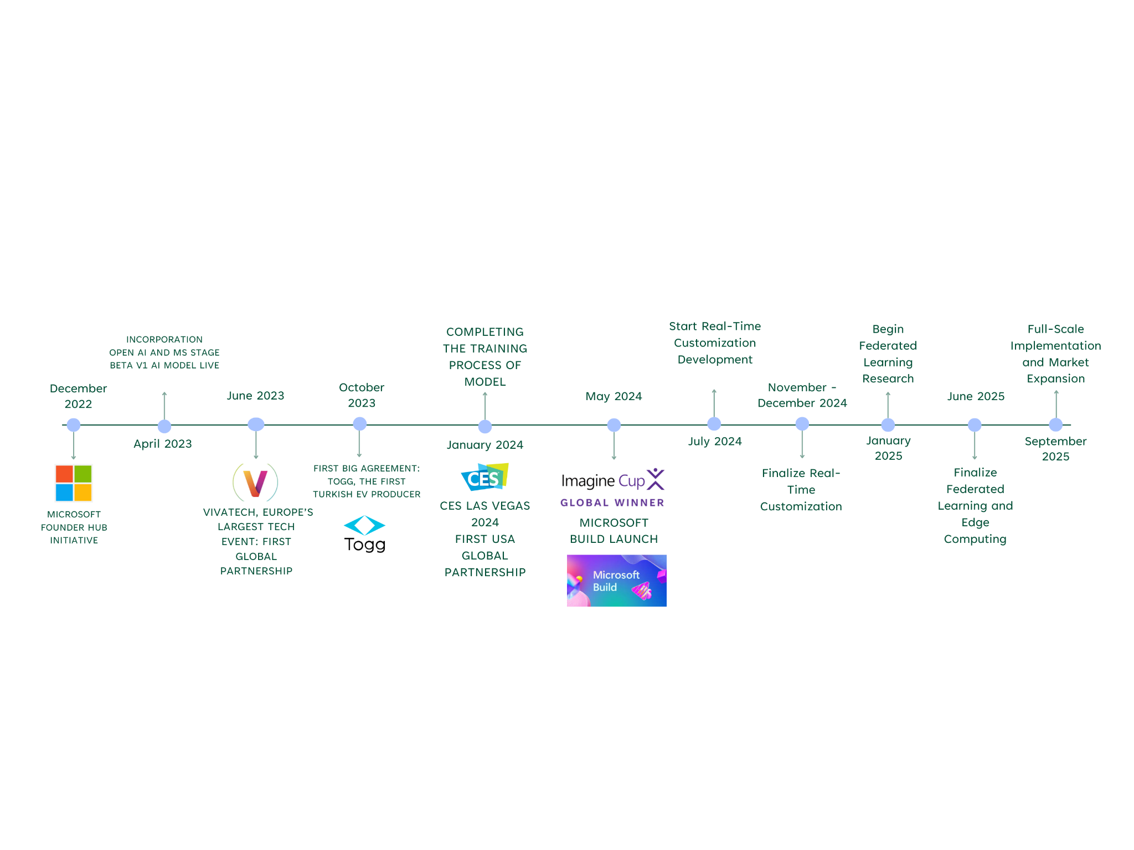
MILESTONES

Slide 14
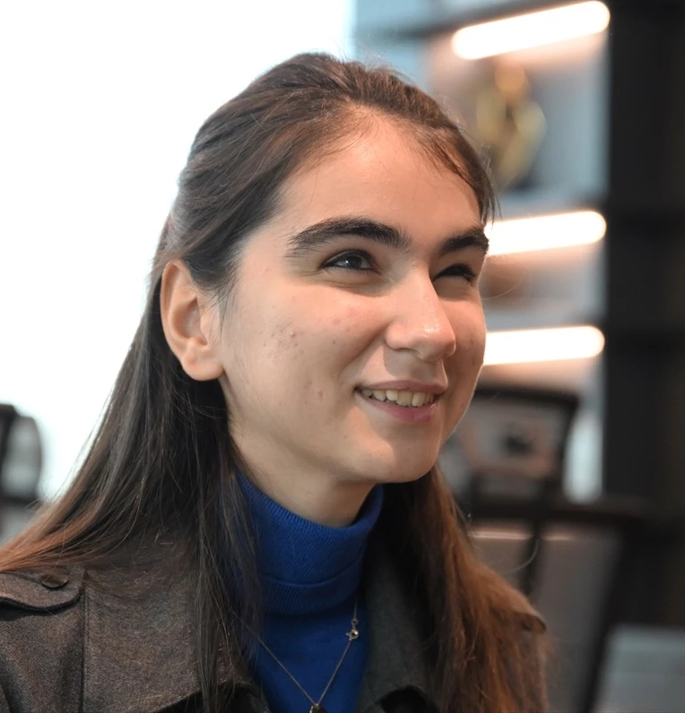
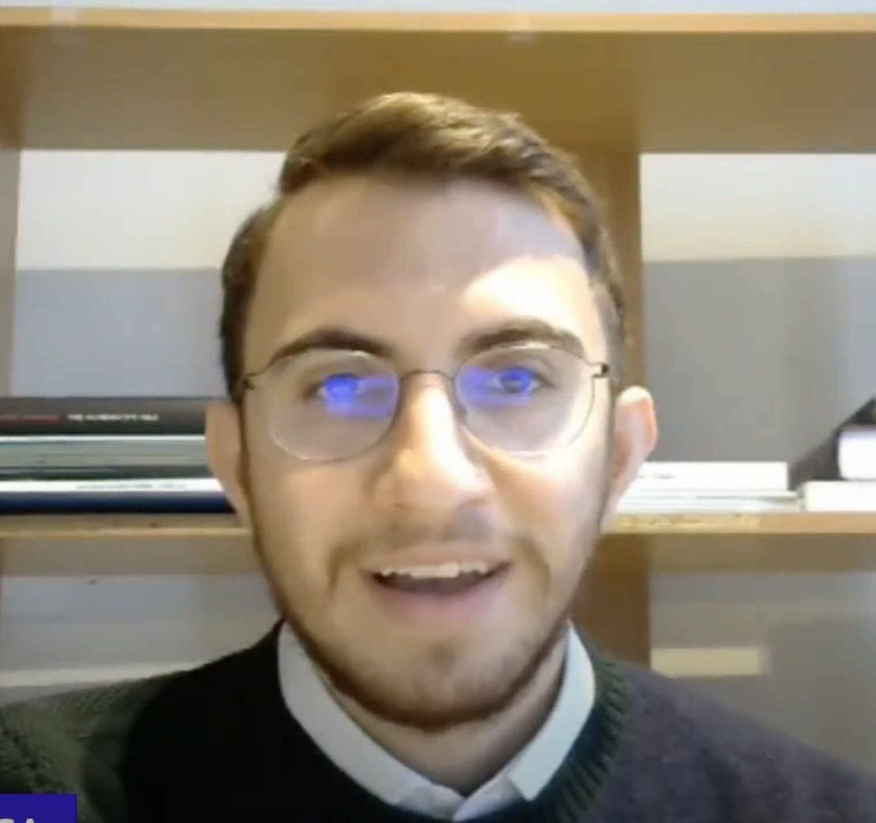
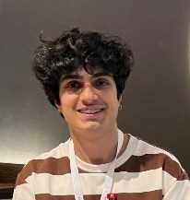
MEET THE TEAM
ZULAL TANNUR
NEJAT EGE KETREZ​
EMRE YILDIZ​
Founder & CEO
CTO
Mobile Dev

Slide 15
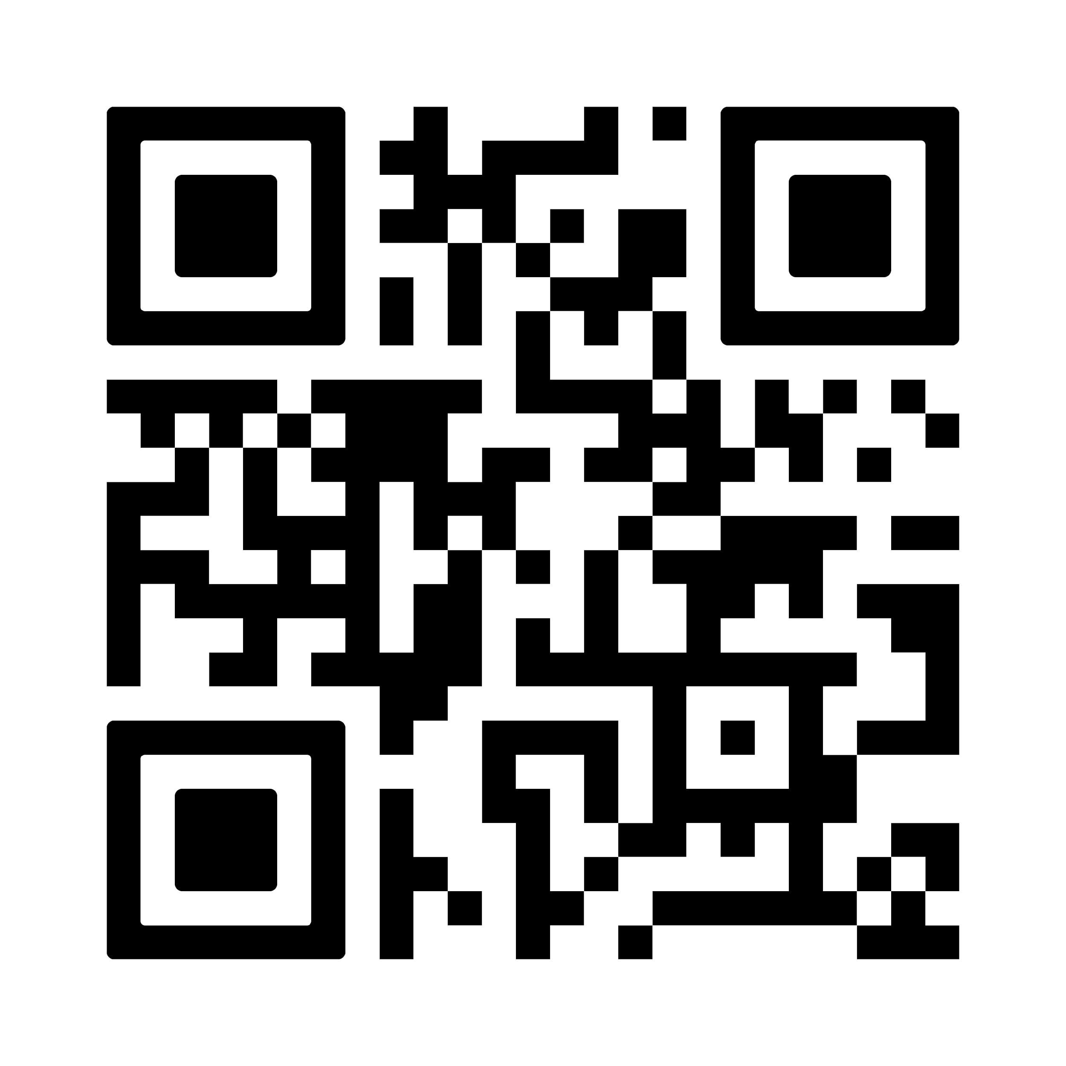
THANK YOU
Zülal Tannur
+90 545 390 05 57
zulal.tannur@fromyoureyes.app

